Slide 1


Software Engineering and
Project Management
Customer Credit Transfer
CSE 312
BackBenchers
IIITK
Zishan Ahamad
Vatsal Sinha
Sagar Raj
Yogesh Raj

Slide 2
Structured Design
In this phase, Conversion to DFD into structured chart take place which basically represents the software architecture i.e
various modules making up the system,
module dependency (i.e. which module calls which other modules),
parameters passed among different modules.

Slide 3
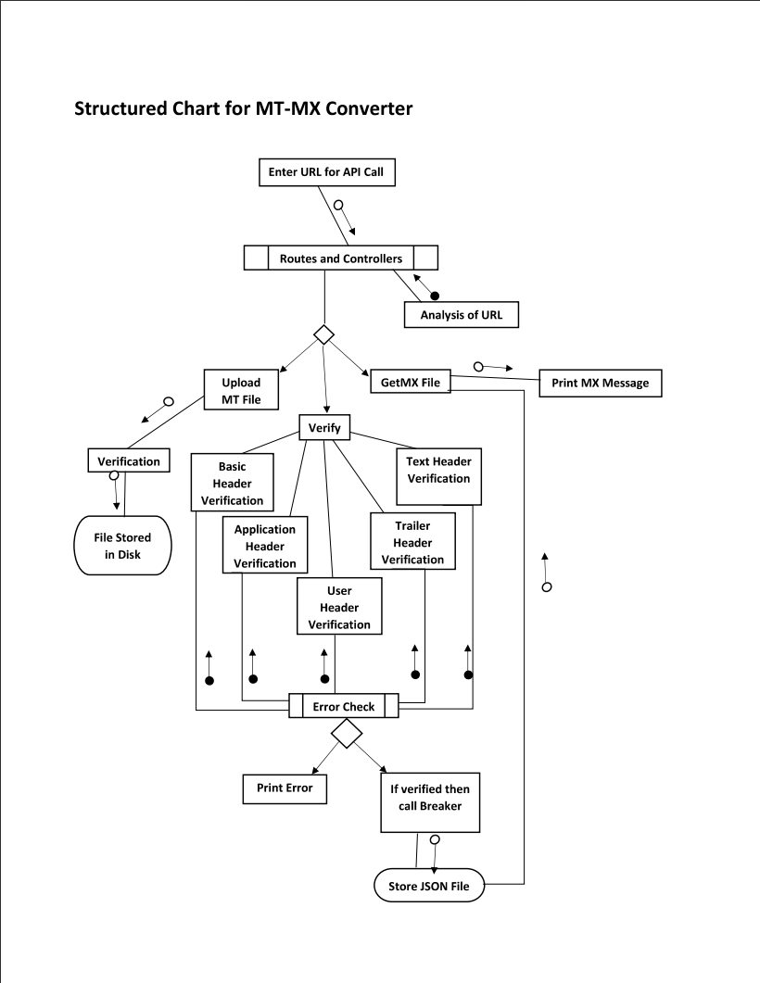
Structured Chart for MT-MX Converter

Slide 4
THANK YOU

